Slide 1
A PRESENTATION ON THE TOPIC POLYMERIZATION
By group 6
Petrochemical Engineering II
Ms. Mac-Acquaye Victoria
Mr. Kugbe Selorm A.
Mr. Ntow Manfred E.
Mr. Ofosu Bismark
LECTURER: Dr. E. G. Ankudey

Slide 2
POLYMERIZATION
General overview
Fundamentals -Ms. Mac-Acquaye Victoria
Reactions - Mr. Kugbe Selorm A.
Techniques - Mr. Ntow Manfred E.
Physical properties - Mr. Ofosu Bismark
Classifications - Mr. Ofosu Bismark

Slide 3
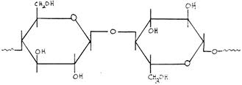
POLYMERIZATION
Polymerization is a reaction in which macromolecules are formed by combining small molecules.

Slide 4

POLYMERIZATION
A monomer is a reactive molecule that has at least one functional group (e.g. -OH, -COOH, -NH2, -C=C-).
A copolymer, results from two different monomers by addition polymerization.

Slide 5
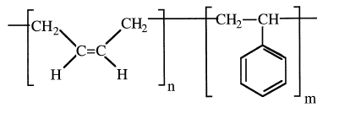
POLYMERIZATION
Block copolymers are formed by reacting two different prepolymers .
A block copolymer made of styrene and butadiene

Slide 6

polymerization
Alternating copolymers have the monomers of one type alternating in a regular manner with the monomers of the other.

Slide 7
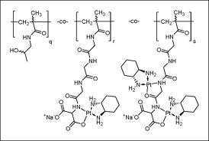
polymerization
Random copolymers have different monomer molecules distributed randomly along the polymer chain.

Slide 8
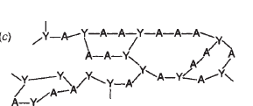
polymerization
Crosslinked polymers have two or more polymer chains linked together at one or more points other than their ends.

Slide 9
REACTIONS.
Addition polymerizations reactions and
Condensation polymerisations.

Slide 10

REACTIONS.
ADDITION POLYMERIZATION
In addition polymerization, a chain grows simply by adding monomer molecules to a propagating chain.
Addition polymerization initiators are free radicals, anions and cations.

Slide 11
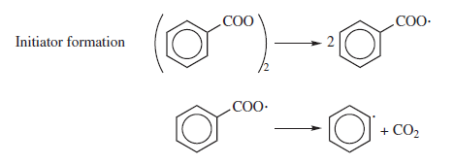
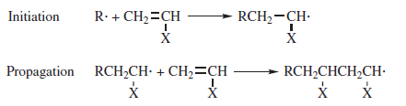
Free Radical Polymerization
Benzoyl peroxide
Benzoylperoxy radicals
Phenyl radical

Slide 12

Free Radical Polymerization
= alkyl, halide etc
. Where R= alkyl, aryl and R’= free radical and X= halide/akyl
.

Slide 13
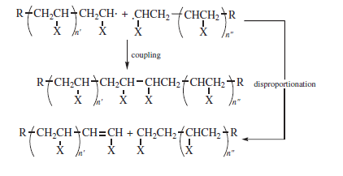
Free Radical Polymerization
CHAIN TERMINATION

Slide 14
Cationic Polymerization
Strong protonic acids and Lewis acids, such as BF₃, needed with a trace amount of a proton donor, such as water, is normally required.
E.g. water combined with BF₃ forms a complex that provides the protons for the polymerization reaction

Slide 15
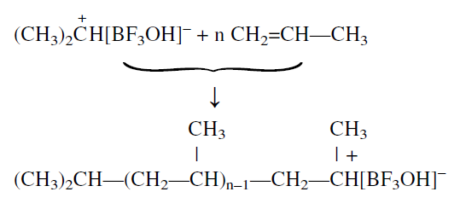
Cationic Polymerization
Next step.

Slide 16

Cationic Polymerization
Cationic polymerization can terminate by adding a hydroxyl compound such as water:

Slide 17
Anionic Polymerization
The initiators, are alkyl and aryllithium in liquid ammonia.
For example, acrylonitrile combined with n-butyllithium forms a carbanion intermediate:
Chain growth then occurs through a nucleophilic attack of the carbanion on the monomer.

Slide 18
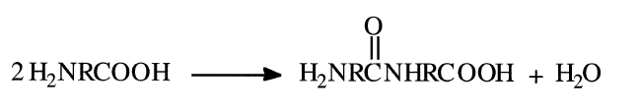
CONDENSATION POLYMERIZATION (Step-Reaction Polymerization)
1.A reaction between two different monomers with a similar functional group. E.g. a reaction of a diacid and diol can produce polyesters.

Slide 19
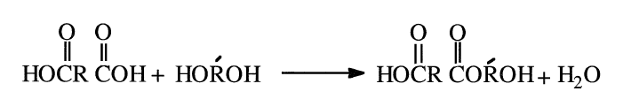
CONDENSATION POLYMERIZATION
2.Reactions between one monomer species with two different functional groups. E.g. polymerization of an amino acid starts with condensation of two monomer molecules:
A small molecule (water) results from the condensation reactions.

Slide 20
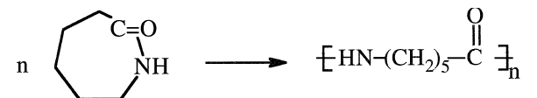
RING OPENING POLYMERIZATION
It produces a small number of synthetic commercial polymers. One important ring opening reaction is that of caprolactam for the production of nylon 6:

Slide 21
POLYMERIZATION TECHNIQUES
Polymerization reactions can occur in bulk, in solution, in emulsion, in suspension, or in an interfacial process.
In solution polymerization, an organic solvent dissolves the monomer.
Emulsion polymerization is widely used to produce polymers in the form of emulsions.
.

Slide 22
POLYMERIZATION TECHNIQUES
In suspension polymerization, the monomer gets dispersed in a liquid, such as water
Interfacial polymerization is mainly used in polycondensation reactions with very reactive monomers.

Slide 23
PHYSICAL PROPERTIES OF POLYMERS
MELTING POINT.
The freezing point.
the Glass transition temperature (Tg).
Crystalline melting point, Tm.
Examples
Nylon Tg = 47°C and Tm = 235°C
Polystyrene Tg = 94°C and Tm = 140°C
Celllulose Tg = 111°C and Tm = 300°C
.

Slide 24
VISCOSITY
A polymer with a high melt flow index has a low melt viscosity, a lower molecular weight

Slide 25
CRYSTALLINITY.
Two factors govern the tendency of a polymer to crystallize.
chains will pack into a crystal and is the magnitude of the attractive force.

Slide 26
CRYSTALLINITY.
Crystalline polymers are opaque.
Amorphous polymers are transparent and glasslike.
Hydrogen bonding

Slide 27
CLASSIFICATION OF POLYMERS.
Elastomers, plastics, fibers, surface coatings, and adhesives.
Plastics
Plastics are relatively tough substances
E.g. poly vinyl chloride ( P V C)

Slide 28
CLASSIFICATION OF POLYMERS
Thermoplastics and thermosets.
Thermoplastics can be resoftened by heat and thermosets cannot be resoftened.
Examples of thermoplastics; polyethylene and polypropylene
Examples of thermosets; phenolfomaldehyde
and polyurethanes.

Slide 29
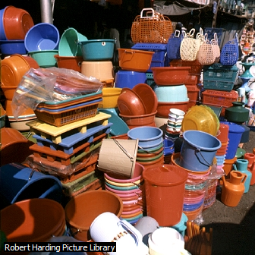
CLASSIFICATION OF POLYMERS
PLASTICS

Slide 30
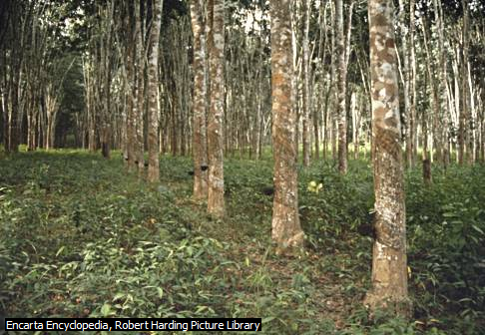
CLASSIFICATION OF POLYMERS
Synthetic Rubber
Synthetic rubbers (elastomers) have high molecular weight
Example; Polybutadiene

Slide 31
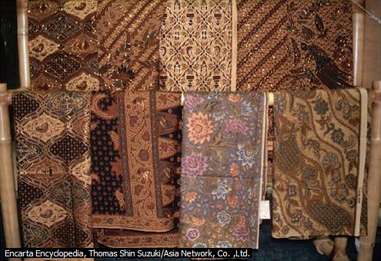
CLASSIFICATION OF POLYMERS
Synthetic Fibers
Synthetic fibers are long-chain polymers
Example; nylon

Slide 32
END OF PRESENTATION

